Slide 1

Department of Computer Science
Senior Comps
Ben Aoki-Sherwood, David Chu, Kevin Chen,
Anna Neiman-Golden, Chisomnazu Oguh, Lita Theng
Advised by Professor Sneha Narayan
Notes:
CHISOM
Welcome everyone! My name is [go around with introductions] and this is our presentation of our comps. Our comps is titled… (switch slides)
mention Lita’s name
“and Lita Theng, who could be not here with us today”

Slide 2

Is a dollar worth a thousand words?
Visualizing the Connections
Between U.S. Congress Members’ Funding and Speech
Notes:
CHISOM
“Is a Dollar Worth a Thousand Words?: Visualizing the Connections Between U.S. Congress Members’ Funding and Speech”. To give you a general idea of what we are going to talk about, David has something to show you. (switch to David’s animation slide)

Slide 3







I’m Ben, and I want to run for the Senate
But ummm, I need money though
Hey Chief, we got the cash for ya
I love sleeping, just like how I love Carleton #carls
Hey make sure you mention us
Bet
Carleton taught me many great ideas, such as sleeping.
1 year after, our boy Ben got into the Senate ✨

Slide 4


U.S. House
U.S. Senate
Notes:
BEN
For this project, we focused on FEDERAL congress people- members of the US House and US Senate.

Slide 5
Background
US congress people fund campaigns through contributions
  Individuals and PACs
These contributions influence political focus & discourse
Favorable Legislation
?
Reduced Regulations
Campaign Contributions
Political Speech
Political Appointments
Government Contracts
Notes:
US congress people are constantly thinking about their next re-election campaigns: Representatives are up for reelection every 2 years, and Senators every 6.
These campaigns are costly; to fund them, congress people rely on contributions, which can come either directly from individuals (organizations or actual people) or through Political Action Committees (PACs), organizations which pool contributions.
OpenSecrets, a watchdog organization that collects data on campaign funding & expenditures: a campaign contribution may carry an expectation that the money will be repaid in the form of favorable legislation, less stringent regulations, political appointments, government contracts or tax credits
But, what we want to explore what influence campaign funding has on political rhetoric: on what congresspeople are talking about.

Slide 6






Project Overview
Funding Data
Frontend
Tweet Data
Topic Modeling (LDA)
Database
Backend
Statement Data
Notes:
BEN
To explore that influence (that I mentioned on the previous slide), we created an exploratory visualization tool.
The data we visualized was campaign funding data aggregated into “industry” categories from OpenSecrets,
and we proxied politicians’ rhetoric using Tweets from Twitter and statements made in Congress from the Congressional Record at Congress.gov.
To summarize what politicians were actually talking about, we extracted the topics from these data sources using the LDA Topic Model.
In terms of project architecture, we stored our data in MongoDB database and served data to our React.js frontend using a Python Flask backend.
First, I’ll pass it off to Kevin to talk about our data sources.

Slide 7

Data: Funding
Notes:
KEVIN:
Now, we’ll begin talking about our sources of data for this project. Our congresspeople funding data came from OpenSecrets, the “nation's premier research group tracking money in U.S. politics. They provide lots of useful analysis on campaign financing and lobbying, but they also provide free API’s that allow people like us to access their data.
We utilized OpenSecrets to obtain several types of data, but the primary one we used for this project was the top industries for particular congressperson.

Slide 8

Data: Tweets
Compiled official congressperson Twitter accounts
Sampled 100 tweets per congressperson
Source: @SenAmyKlobuchar, Twitter.com
Notes:
Ben
We pulled Tweets directly from Twitter’s API, using a list of official twitter accounts for Congresspeople.
These are accounts like @SenAmyKlobuchar, and are usually NOT the same as a congress person’s personal account.
In total, we collected over a million Tweets–all Tweets made by the official accounts. However, for the purposes of tractability in the topic modeling process, we subset this to a stratified random sample of 100 tweets per congressperson.

Slide 9
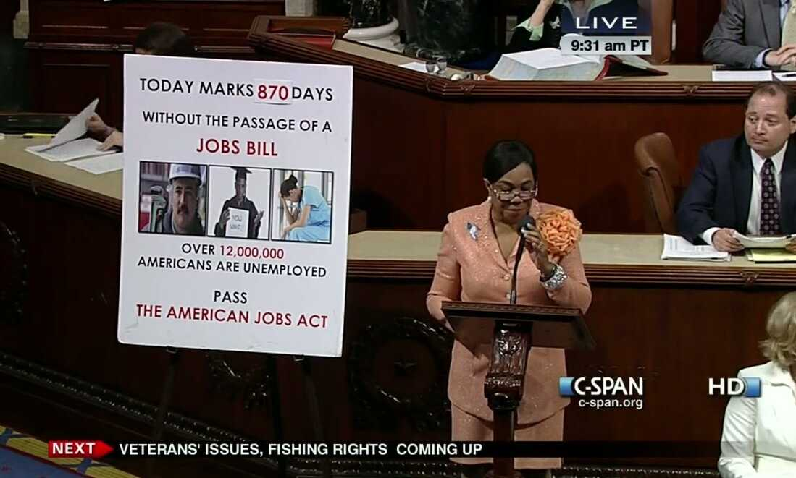
Data: Statements
Statements made on Congress floor
Congress.gov API
Congressional Record PDFs
117th Congress (Jan. 2021 - Dec. 2022)
Source: npr.org
Notes:
Ben
first considered press releases (propublica). Form was so unstandardized that scraping would be infeasible
after a little more digging, found congress.gov API - Congressional Record endpoint, where we got PDFs of the full record for each day from Jan 2021 to Dec 2022,
the years of the 117th Congress. **important to note that this timeframe was limited, unlike the time over which we collected tweets**
Congressional Record contains transcriptions of remarks made in the House and Senate, including hearings, debates on bills, votes, and procedural matters. As you can imagine, this record is pretty messy; Anna will talk about how we tried to clean it up.

Slide 10
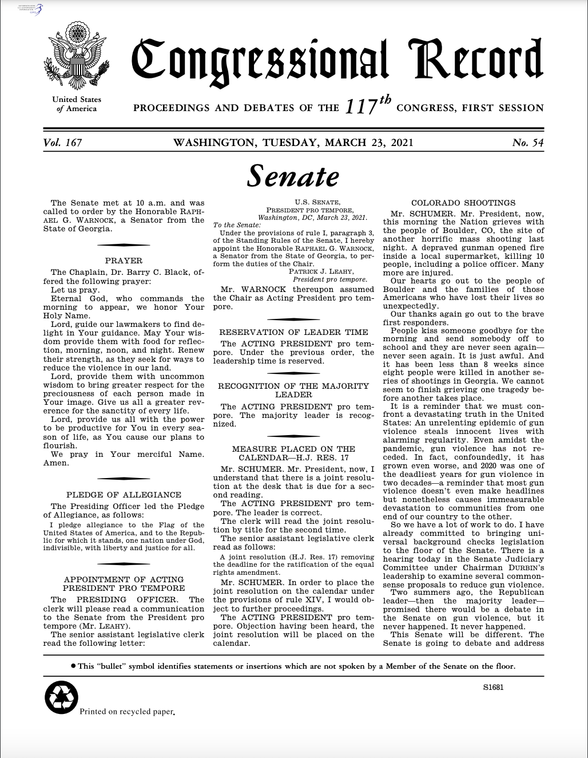
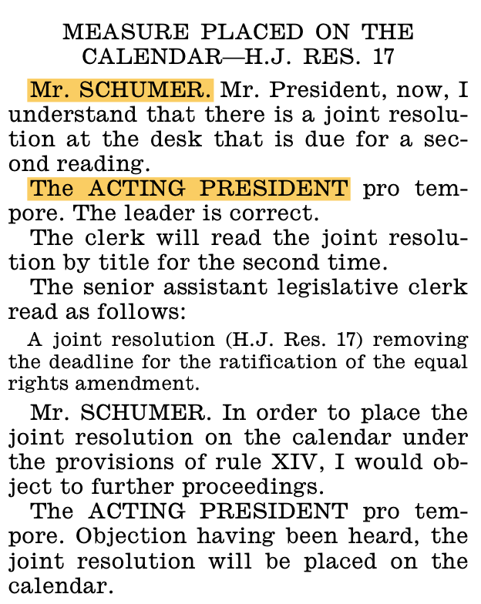
Data: Statements
Converted to plain text using OCR
Looked for speech delimiters and speaker tags
Parsed with regular expressions
Repeated on pdf for each day of 117th congress
Notes:
Anna
Started with pdfs from every day of congress
Needed to extract representative speeches from pdfs
First, used OCR (Optical character recognition) to extract the plain text of the pdfs
(Used the python library PyPDF2)
ocr in itself is imperfect and did some weird things w footers and the like
Then, we actually had to extract the speeches from the rest of the text in the record
To find speeches, we looked for speaker tags, like “Mr. SCHUMER”, which showed us where speeches started
Finding the ends of speeches was a bit more complicated, since there were many different ways they could end
We ended up adding special characters before certain common ending phrases or breaks in the page or looking for the next speaker tag
Once we had identified these speaker tags and speech delimiters, we used regular expressions to find them and extract the text in between
We then repeated this parsing on every pdf for each day of the 117th congress, to extract the statements and store them in a database
(But even after all of our parsing, data needed to be further cleaned for topic modeling (will be touched on later))

Slide 11
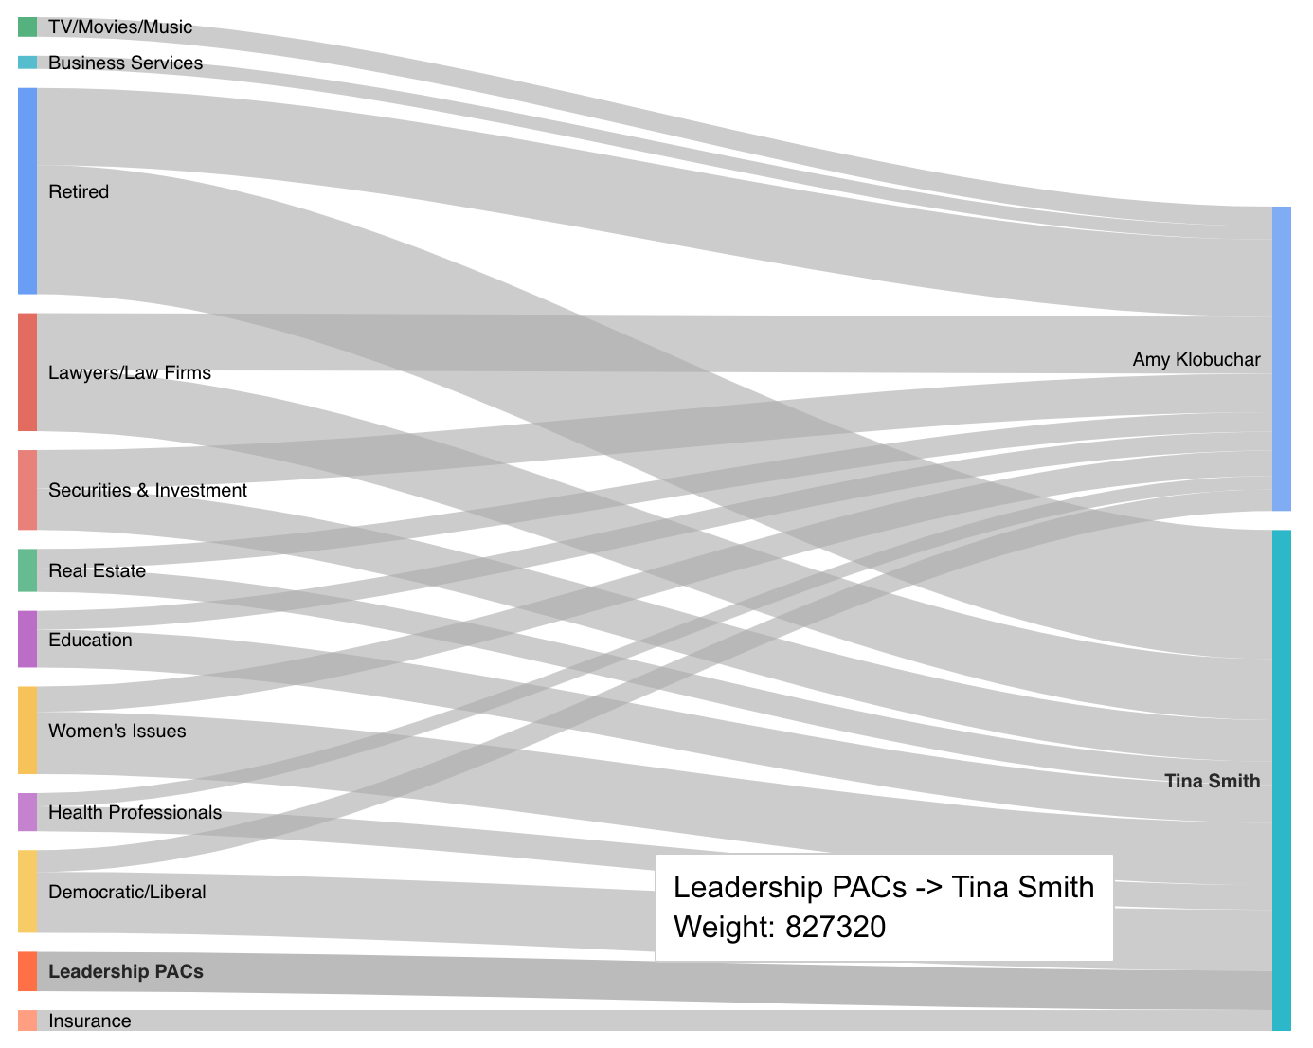
Front End: Representing the Data
Data visualization best practices
  Simple and functional visuals
  Side by side comparison
  Full dataset and subsets
Sankey diagrams
  Flow diagram where the width of the flow is proportional to the quantity represented
Notes:
Anna
So how did we actually display all this data?
When we first started, we did research on data visualization best practices, specifically for open gov data
Some of the principles we came across
Make visuals simple and functional first
Allow for side by side comparison
Show full data set but also allow for zoom, filter, search so ppl can examine subjects of interest
Based on these principles and our dataset, we decided on using sankey diagrams
What is a sankey diagram? A type of flow diagram where the width of the flow is proportional to the quantity represented
Here is an example from our website, for funding data
The left side is industries, the right is politicians
The weights of the flows are amounts of money (800 thousand)
Sankey diagrams are relatively straightforward, allow for comparison between politicians, and the flow visual matches what we are trying to show in our project

Slide 12
Front End: Representing the Data
Considered many different approaches/types of charts
  Bar charts
  Sample speech/word clouds
  Exploratory database
Wanted to be able to compare multiple politicians’ funding and speech data at once
Notes:
Anna
As we actually collected the data, our design shifted several times.
We considered switching to bar charts – but we wanted to depict a flow, and hopefully make it easier to compare between funding/speech
We thought a lot abt how to show the speech data – quantitative v. qualitative speech data – word clouds, sample tweets
Weren’t sure how to quantitatively show speech data
For a while, considered doing more of an exploratory database that allows you to look into one politician in depth
(We also thought about aggregating across groups – like republicans, senators, specific states – but turned out to not be very interesting, especially for speech (too uniform))
Ultimately decided it was more valuable to be able to compare both speech and funding data across politicians at once, which brought us back to the sankey

Slide 13
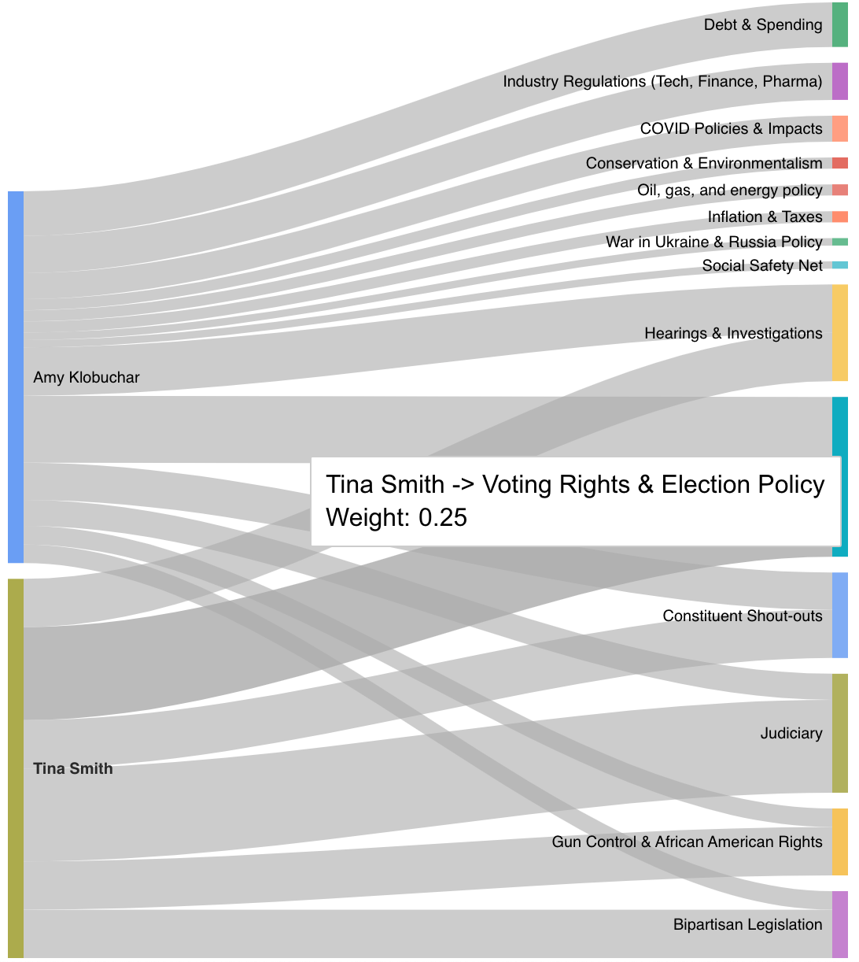
Front End: Representing the Data
Used Google charts
Fetched and formatted data from API
Dealt with scaling issues for statement data
Notes:
Anna
Actually implementing the visualization was its own challenge
We used google charts to create our diagrams
This had the benefit of being simple and easy to learn, however there is not a ton of customization ability
Fetched and formatted data from api
The biggest challenge that implementation brought up was how to visualize the statement data and the speech data concurrently given different scales
To present our speech data, we decided to use the proportion of tweets/statements belonging to a specific topic as the weight in our sankey diagram
Like in this example from our website, 25% of Tina Smith’s tweets fall into the category of Voting rights and election policy
Where these numbers / topics come from will be touched on later in the presentation
We wanted to have a sankey chart with both speech and funding data (3 columns)
but had issues of scale – funding numbers are very big, thousands of dollars, speech numbers are small, less than 1
Ended up deciding to show separately so the values remain meaningful
Now, I’ll pass it over to Kevin to talk about the backend of our project

Slide 14
Backend: Technologies
Notes:
KEVIN:
Now, I’ll talk about the technologies that powered the backend of our app. To serve the data to the frontend of our app, we needed an API, which we created using Flask. To store the data we collected, we used a MongoDB database.

Slide 15
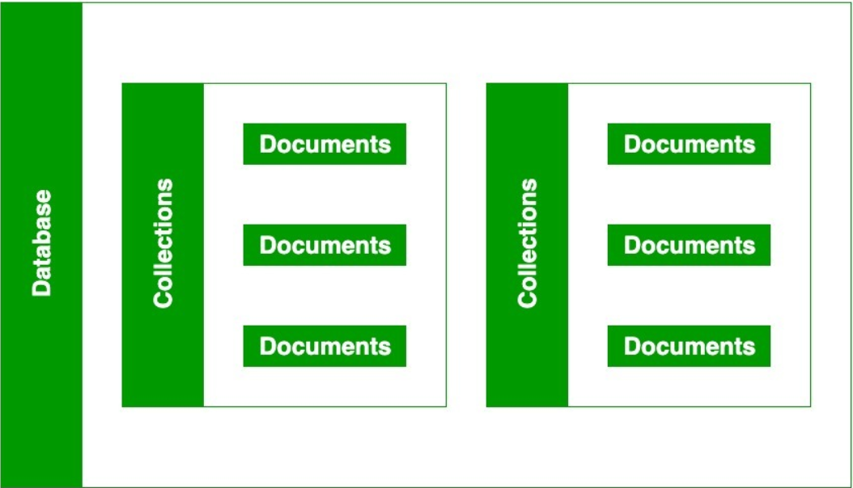
Backend: Data Organization
Notes:
KEVIN:
A MongoDB database consists of one or more collections, which consist of one or more documents. In our case, we had a collection storing all information on congresspeople, a collection storing all topic distributions for Tweets, and a collection storing all topic distributions for statements.

Slide 16
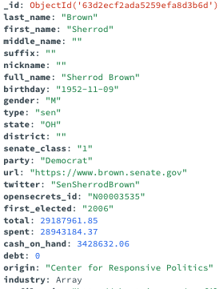
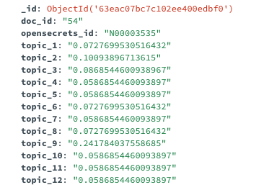
Backend: Data Organization
Notes:
KEVIN:
So here’s a quick example. On the left, this is the information we collected for this congressperson. We have all of their demographic information along with the top industries that fund them, which is the “industry” field.
On the right, we have the information for a particular Tweet. We track who made the Tweet along with the topic distribution for that Tweet, or essentially numbers that each indicate how much the Tweet belongs to that topic. As for how we got that information, I’ll introduce the idea of Topic Modeling.

Slide 17
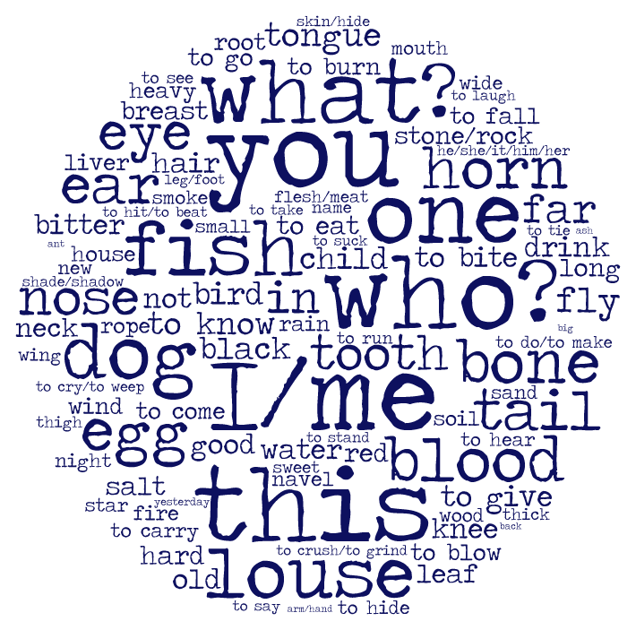
Topic Modeling: Introduction
animals
dog, bird, fish, …
subjects
you, I/me, who?, ...
organs
tooth, bone, tail, blood, mouth, nose, …
Notes:
DAVID
Topic modeling is an unsupervised machine learning technique in natural language processing that aims to take a collection of documents CLICK and automatically identify and cluster topics present in them.

Slide 18
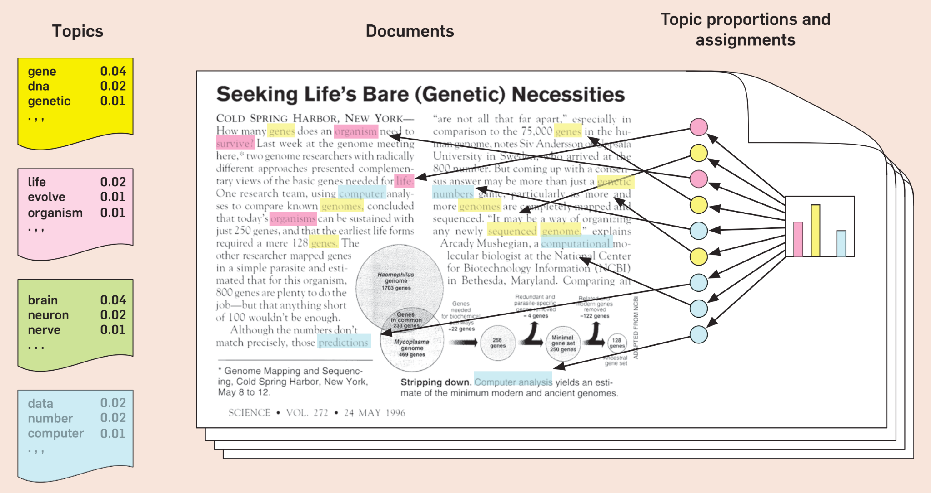
Topic Modeling: Latent Dirichlet Allocation
Notes:
DAVID
There are many different approaches that can be used for topic modeling, but the technique we used is called Latent Dirichlet Allocation (LDA). There are two main ideas in LDA: each document is a mixture of a set number of topics, and each topic is a probability distribution over the words in the text. CLICK During the modeling process, LDA assigns each word in a document to a topic based on its probability of occurring in that topic, and updates all the topic distributions based on the observed word-topic assignments. The final output of LDA is a set of topic distributions that indicate the probability of each topic being present in each document, and a set of word distributions that indicate the probability of each word being present in each topic. Before actually using LDA, however, we needed to first clean the text data, which I’ll let Ben talk about.

Slide 19

Topic Modeling: Text Preprocessing
Remove stop words
Remove non-ASCII characters
Remove URLs
Remove punctuations
Remove repetitive words: Mr., Mrs, Sir, …
Remove U.S. states
Remove first three sentences of statements
travel state talk veteran pact act thing hear important care veterans family care provide health care worker meet chalmers
Notes:
Ben
Tweets, like most social media posts, are often messy and can contain lots irrelevant information that can reduce the accuracy of our analysis. To improve our model, we needed to perform lots of text sanitization processes such as:

Slide 20
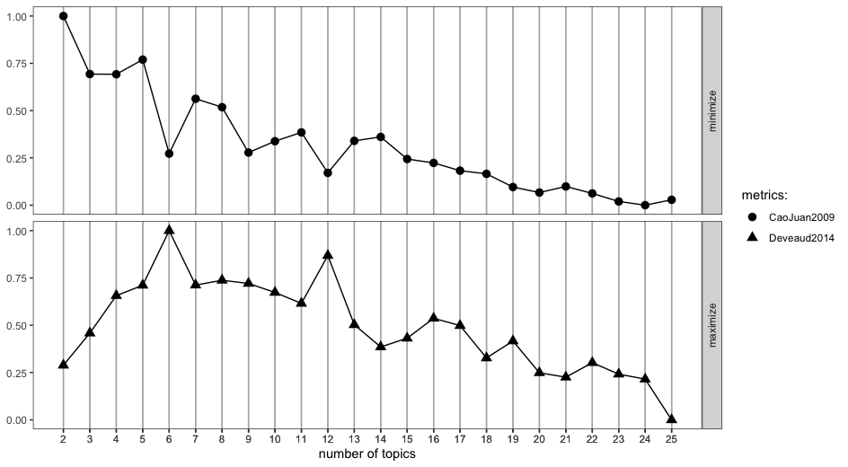
Topic Modeling: Number of topics
Run the model on various number of topics using the Cao Juan (2009) and De Veaud (2014) metrics
Notes:
DAVID
To use LDA, it’s necessary to specify the number of topics. The number of topics is a hyperparameter, which is a number we manually set and can affect the performance of the model. To do this, we used 2 metrics– the Cao Juan and the De Veaud metrics– and ran the model on a wide range of numbers. Then, we selected the number that minimizes the Cao Juan metric and maximizes the De Veaud metric.
After we have narrowed down the potential number of topics we want to use, we would evaluate the topics ourselves and see which ones worked best.

Slide 21
Topic Modeling: Results
k topics
. . .
"covid" "pandemic" "need" "vaccine" "work"
"job" "business"
"million" "mandate" "relief"
"help" "plan"
"border" "country"
"crisis" "drug"
"illegal" "policy" "immigration” "number"
"fentanyl" "immigrant" "patrol"
“admin”
"tax"
"pay" "year" "inflation" "democrats" "money" "spend" "debt"
"billion" "spending" "trillion" "cost"
"community" "infrastructure" "water" "land" "national"
"project" "federal" "local" "resource" "fund" "include"
"transportation" "public"
Notes:
DAVID
After choosing our number of topics k, the model will cluster our text corpus into k topics. CLICK Each topic will be an ordered list of words ranked on how relevant the model thinks a particular word belongs to a topic. This is done in aggregate of all our of our data.

Slide 22
Topic Modeling: Results
k topics
. . .
Doc 1
14%
6%
5%
. . .
4%
Doc 2
5%
11%
6%
. . .
20%
Doc 3
9%
8%
. . .
5%
13%
. . .
. . .
Notes:
DAVID
Furthermore, for each document, we will have a breakdown of the probability distribution of the topics. CLICK These numbers indicate how likely a document is classified to a certain topic. In our tool, we then collect this information for all documents from a certain congressperson or group of congresspeople to get a glimpse into the topics that they talk about most.

Slide 23
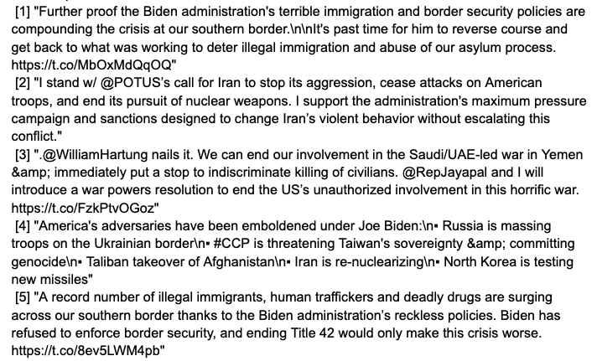
Topic Modeling: Labeling topics
Foreign Policy/immigration
Notes:
KEVIN:
Once we have used LDA to extract the topics from our Tweets and Statements, it was up to us to manually inspect those topics and give them labels.
For each topic, we queried the Tweets that had the highest probability of belonging to that topic. We would carefully read over these Tweets and try to come up with a topic label that would make sense. Here’s an example. You can take a moment to read them over and see if you can come up with anything … The label we ended up giving this topic was “Foreign policy/immigration”.
Clearly this is a subjective process; there are many possible label names we could have given each topic, but we tried our best to come up with ones that encompassed all documents classified into that topic. This was also an iterative process, as we encountered topics that were not useful. For instance, on one iteration of topic modeling we encountered a topic that consisted on entirely Spanish tweets. We would then refine our text preprocessing procedure and try again.

Slide 24
Topic Modeling: Tweet Labels
1. Constituent Outreach
2. Events/Self-promotion
3. Honoring Public Servants
4. Foreign Policy/Immigration
5. Events/Self-promotion
6. Partisan Attacks
7. Healthcare & Public Health
8. Gun Control & Civil Rights
9. Infrastructure & Sustainability
10. Judiciary & Civil Rights
11. Covid Relief & Government Assistance
12. Fiscal Policy & Inflation
Notes:
KEVIN:
After doing many rounds of modeling, we arrived at our final set of Tweet labels. These were our final set of labels, but they weren’t perfect. As you can see, we labeled topics 2 and 5 as “Events/Self-promotion”, as we couldn’t make a clear distinction between them. So in our tool, we simply merged them into one topic.

Slide 25
Topic Modeling: Statement Labels
15. Junk
16. Conservation & Environmentalism
17. Oil, Gas, and Energy Policy
18. Gun Control & African American Rights
19. Hearings & Investigations
20. War in Ukraine & Russia Policy
21. Junk
22. Industry Regulations
23. Bipartisan Legislation
24. Voting Rights & Election Policy
25. Foreign Policy & Protecting Democracy Abroad
1. Junk
2. Debt & Spending
3. Social Safety Net
4. Inflation & Taxes
5. COVID Policies & Impacts
6. Junk
7. Junk
8. Judiciary
9. Equality & Civil Rights
10. Immigration & Border Policy
11. Junk
12. Healthcare & Public Health
13. Constituent Shout-outs
14. Junk
Notes:
KEVIN:
Here are our final set of statement labels. As with the Tweet labels, these were definitely not perfect. The topics that were coherent tended to be very good; the documents that were assigned to these topics had much higher probability values than we saw with the Tweets, which we attribute to the fact that the statements are simply longer.
However, as one can see, there are 7 junk topics: 1, 6, 7, 11, 14, 15, and 21. These were topics that we simply could not intuit a label for. We suspect that these topics are a result of messiness in our statement data. Although we spent a huge chunk of time cleaning the data using regular expressions, there were still many undesirable words that made it through. To deal with this, we simply ignored any documents that were assigned to any of the junk topics.

Slide 26
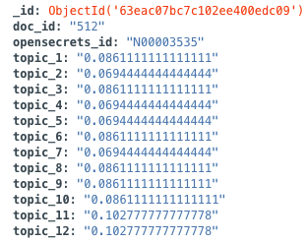
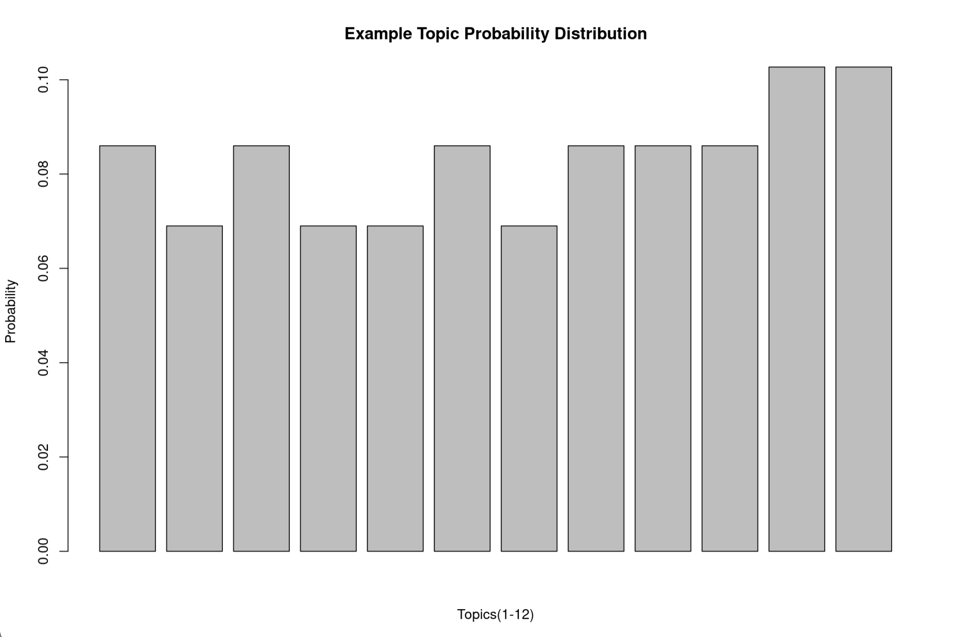
Topic Modeling: Probability Thresholds
Notes:
KEVIN:
So I’ve mentioned how we ignored any statements that were assigned to any of the junk topics, but those weren’t the only documents we chose to ignore. If one recalls from earlier about LDA, each document has its own probability distribution, and these distributions can look vastly different; they can be very uniform, which means that the corresponding document doesn’t really belong to any of the topics.

Slide 27
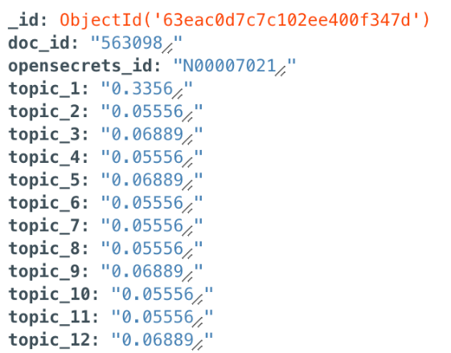
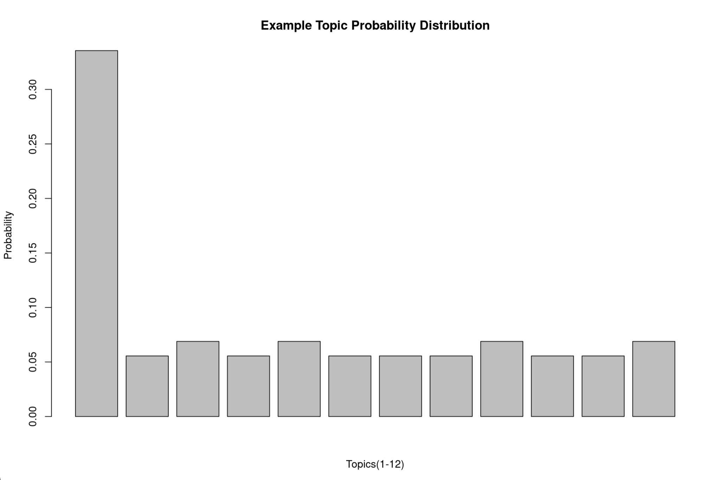
Topic Modeling: Probability Thresholds
Notes:
KEVIN:
Other documents, on the other hand, have very non-uniform distributions. These are the ones we were after, as they provides a useful snapshot into what a congressperson was talking about in that document. So, how do we determine whether a document truly belongs to a certain topic? This question required manual investigation; we had to examine many documents along with their associated probability scores to determine a threshold below which the documents started being unrelated to the topic. For Tweets, we found this threshold to be 0.15, and for statements, we found this threshold to be 0.2. Therefore, for every document, we consider it to be “assigned” to any topic for which the corresponding probability value is greater than those thresholds we set. Now that you understand more about our topics, I’ll let Chisom talk more about the design of the website.

Slide 28
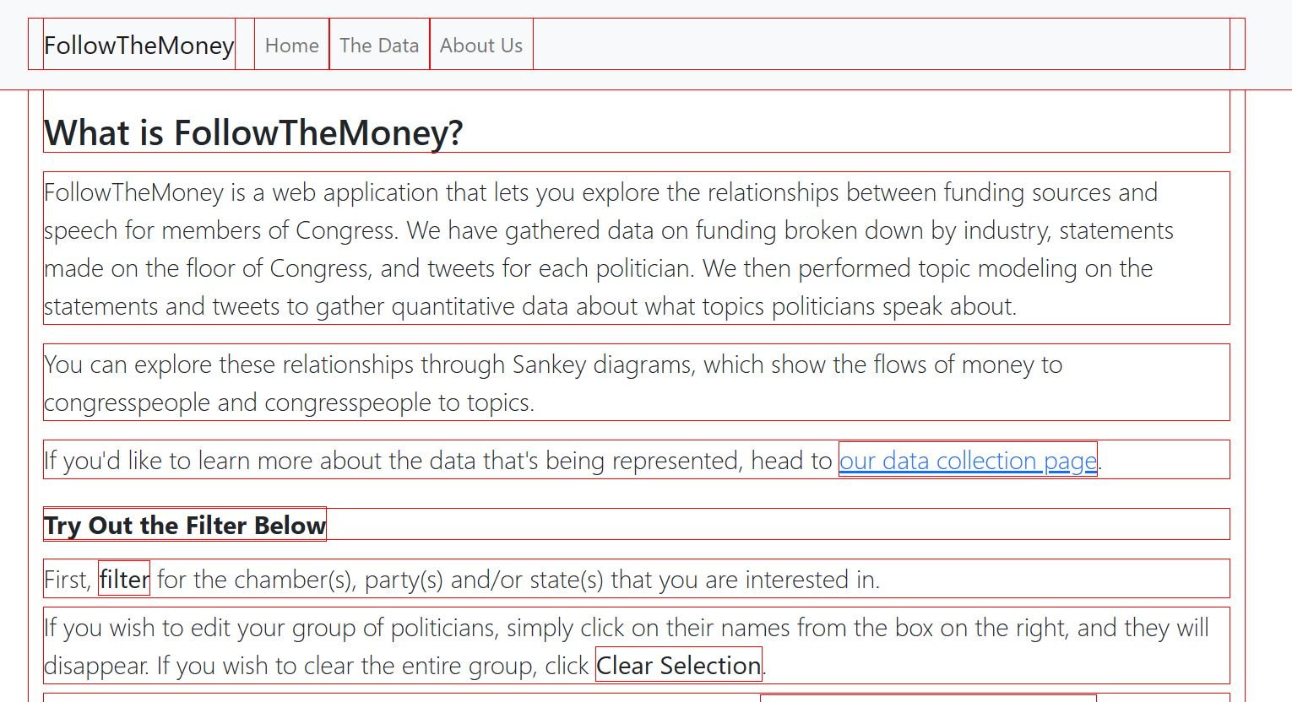
Front End: Designing the Website
Notes:
CHISOM
Has anyone ever used React? (look around the room, maybe show of hands). Even more specific, has anyone used React Bootstrap? (again, look around). Well, for the front-end side of this project, we decided to use React and the its _____ Bootstrap to ease the process of building the website and its different components, such as the navigation bar and unique buttons that we created.

Slide 29
Demo
followthemoneycomps.com
Notes:
Chisom / Anna
(give them 3 min to play around, then move on (minutes includes us walking through it))
Now, we will demonstrate how to use the website. You can also tag along and try it out by typing in this url into your browser (with http:// in front if it asks for it). Note: the website was designed for laptop / computer use, with how the components of the page are structured around each other; however, it is still usable through a phone screen size.
Anna has talked about representing the data. What I focused on the most was figuring out how the user was going to interact with said data. As you can see there, there are a bunch of buttons. Quite a lot of them (if you consider each state having its own individual button). As a user, you can filter the list of federal congresspeople chamber, party, or state (and any combination of those filters). I’m just going to quickly illustrate how you would interact with this filtering system.
Let’s say I want to see information about MN representatives. What if I filter by party? By clicking “filter” after making my selections, the congresspeople that meet that criteria are displayed in the box on the right. Here’s are the republican Minnesotan representatives. And finally those who identify themselves with the Independent party.
Because there aren’t any Minnesotan congresspeople who aren’t associated with the independent party, no one shows up (and in case you’re wondering, there are only two politicians associated with the independent party: Bernie Sanders from Vermont and Angus King Jr. from Maine).
But let’s go back to House representatives from Minnesota. Here they are on the right. Something to note: as you have probably noticed, the buttons with the politicians’ names (which I will call poliButtons) are “filled” in. In other words, they are already pre-selected. So, when the user clicks “Display visualization(s) below”, you will be presented with sankey diagrams that contain information about all of them.
Due to the complexity of the data and the fact that congresspeople can be write tweets about various topics, receive funding from different industries, and talk about a variety of topics, we recommend having up to 10 congresspeople selected before displaying the sankey diagrams because there’s only so much that can be seen without it being overwhelming.
If you want to refine who’s data you see, you can also deselect them and then display their information
Just to give you an example of the data that you would see: if I wanted to know more information about the topics of tweets by the senators from Minnesota, ______ and _____, I would filter accordingly, then click “Display Visualization(s) Below”. This sankey would be one of the three displayed (the other two being industry funding and statement topics), and with it, I can see (include topics and stuff)
Agenda of the demo:
present the site, briefly review over the text on the main page
scroll down and play around with the filtering system; point the following below:
no selection equals all of the politicians listed
same thing if you select all of one category
if none show up (such as independent from Texas), no politicians will show up
demonstrate the sankey diagram with politicians from Minnesota (using examples show before)
remember to deselect and show the modified sankey diagrams
show legend and what happens when you click the links (leading to the data page)
“depending on who you chose, it may look very similar, but all the data is represented”
remember to scroll all the way down…

Slide 30
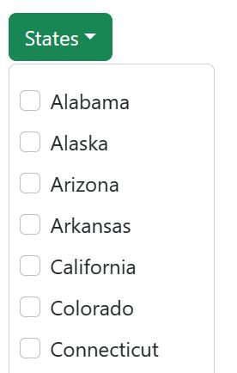
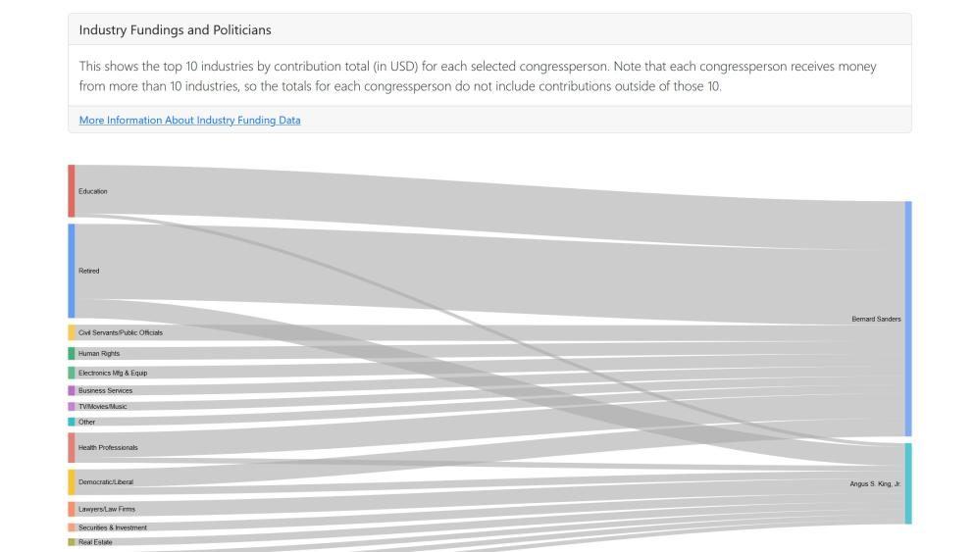
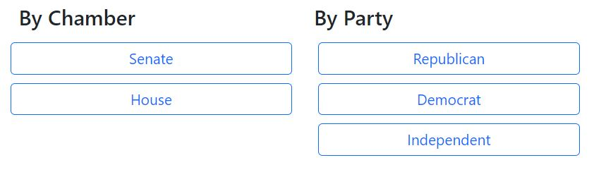
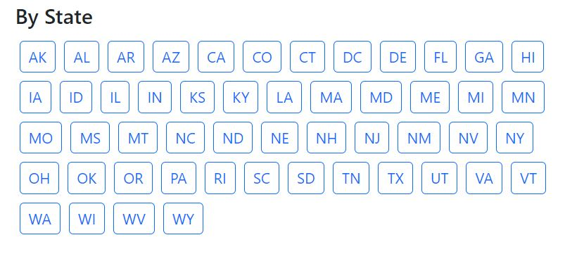
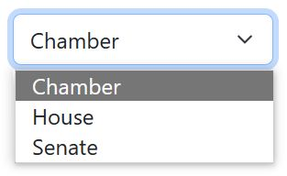
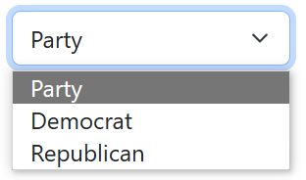
Front End: Usability
Notes:
Chisom
Think about how the readers’ eyes will move across the screen.
An important aspect of front-end design, as you can imagine, is usability. Thinking about how a user will look around a site, trying to figure out how their eyes would track across a page, creating an interface that is not only easy to use, but also easy to understand. When we were designing the layout of the filtering system, these were the kinds of questions we had to ask ourselves:
one (with them showing up with interaction)
two
three
**** hover over the widths to demonstrate the data ****
also how would they input stuff
The different ways to gather user input (dropdown vs buttons vs text)
whole idea of filtered politicians vs selected politicians, but decision to stick with already selected politicians
what about aggregate data? what if you wanted to see just all democrats / republicans as aggregate? if we incorporated it into the filter system, it would look different from all other input … therefore, will move somewhere else (maybe have a tab that contains aggregate data for those interested)

Slide 31
Challenges and Limitations
Design
  Deciding on our final idea/design
  Lack of customization with Google Charts
Speech data
  Accessing and adequately cleaning statements
  Imperfect topic modeling
Losing a team member for a month
Notes:
Anna
Looking back on our project, there are several notable challenges and limitations we faced
It took a really long time for us to figure out our final idea/design
When we first proposed the project, we had a big picture idea for the project but shaky on best way to visualize it
after actually collecting the data, we went through several iterations on how would be best to display it
Trying to see if our original idea was actually feasible given the data we had
Ended up coming pretty close to our original plan, but tried many different things to get there
Using google charts to make our sankey diagrams
Although they got the job done, the framework is very bare bones and didn’t allow us to tweak the charts to our liking
If we were doing future work, we would consider other forms of visualization, such as showing speech over time, since we have dates associated with each tweet/statement
Next, we faced some challenges and limitations with our speech data
As Ben and I both mentioned before, trying to figure out where to get statement data was difficult, and cleaning that data, both when we extracted it and pre-topping modeling was a challenge
And, as we also mentioned before, the topic modeling is not perfect
We had junk topics and duplicate topics, which could probably be resolved with more cleaning
We also tried several methods for topic modeling and multiple iterations for each topic
It was challenging to figure out what model to use, what corpus to run the model on (individual v. group), and how we could actually visualize the results.
In the future, we would explore other models more, such as the Biterm Topic Model
And, last but not least, losing a team member for a month meant we had to shift around roles and responsibilities
That being said, we are proud of what we were able to accomplish over the last two terms

Slide 32
Acknowledgements
Sneha
OpenSecrets, Congress.gov, Twitter
Eric Alexander
Mike Tie

Slide 33
Thanks for watching!

Slide 34
Questions for us?
followthemoneycomps.com

Slide 36
Future Work
Explore other topic models such as the Biterm Topic Model
Alternative data sources:
  Other social media platform
  Voting data
Explore other data visualization techniques:
  Present data over time for multiple congresses
  Group congress people by committee
Notes:
DAVID

Slide 37
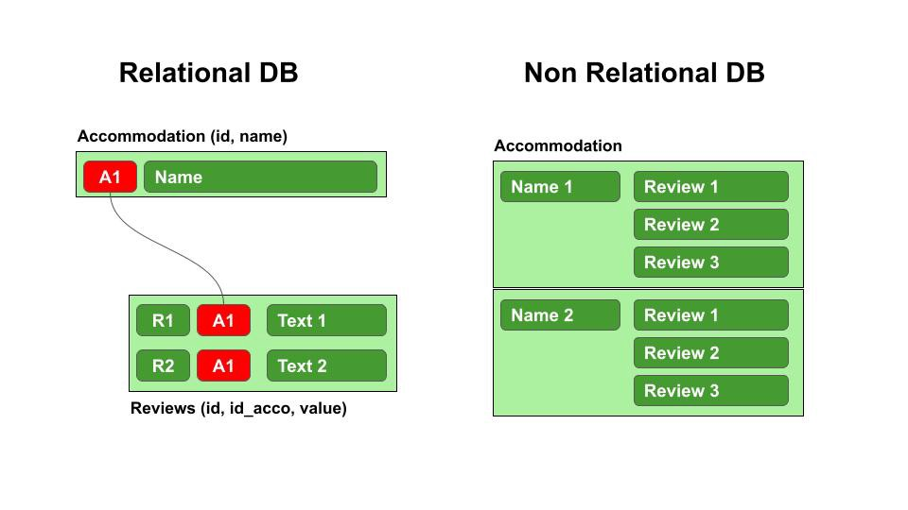
Backend: Database
Notes:
KEVIN:
BACKUP SLIDE:
There are several reasons why we used a MongoDB database as opposed to a relational database. First, we have several distinct types of data– statements, funding data, and Tweets– each with a number of fields and unrelated to the other types. This follows the format of a MongoDB databases, where databases are organized into collections, which hold documents.
Additionally, the format of the data when we collected it is in the form of a bunch of key and value pairs, which naturally suits the format of a NoSQL database.
Faster queries
Static database vs. on-the-fly external API calls Wanted to get aggregated information(republicans, democrats), not possible to make hundreds of API calls instantly API call limit No need since data is not updated often

Slide 38
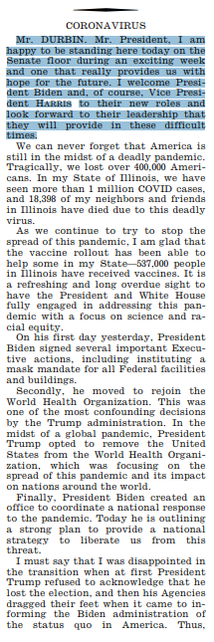
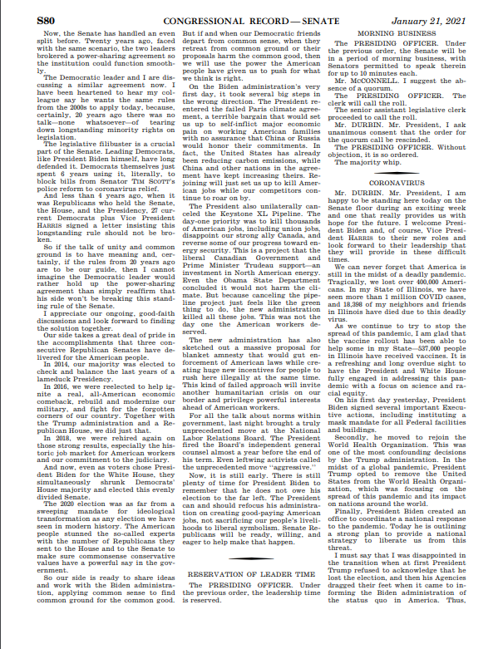
Topic Modeling: Statement Text Preprocessing
Remove first three sentences
Remove stopwords, punctuation, titles, names
Notes:
Ben

Slide 39

Data Sources
Contributions
Tweets
Statements
Notes:
Ben
Funding: opensecrets
Tweets: twitter
Statements: Congressional Record
Congressperson information: opensecrets

Slide 40
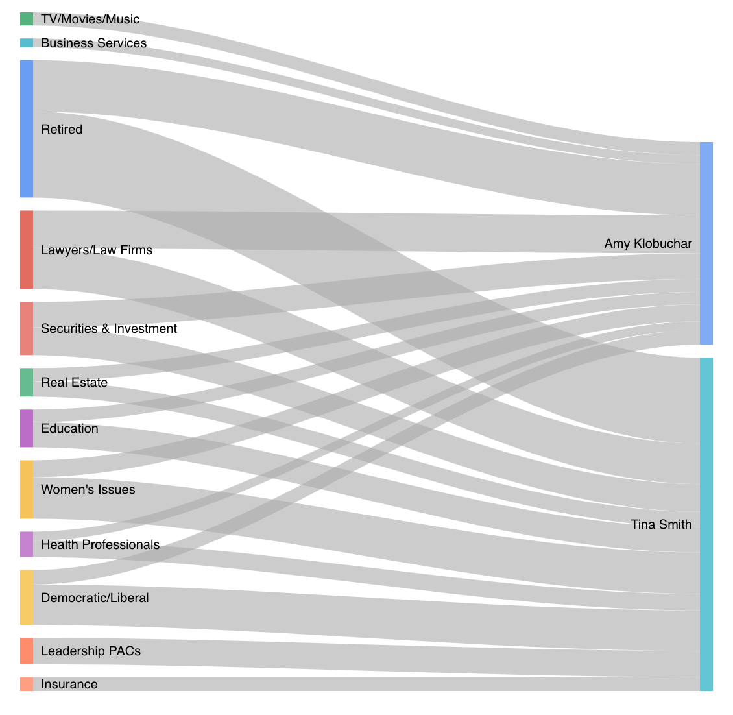
Front End: Representing the Data
What is a Sankey diagram?
A type of flow diagram where the width of the flow is proportional to the quantity represented
Why did we choose Sankey diagrams to represent our data?
Researched data visualization best-practices, specifically for open government data
Considered many different approaches/types of charts
  For speech in particular
Wanted to be able to compare multiple politicians at once
Notes:
Anna
We debated a lot on how to actually show the data and ultimately decided on using sankey diagrams.
So, what is a sankey diagram? A type of flow diagram where the width of the flow is proportional to the quantity represented
And why did we choose them?
When we were trying to decide how to visualize our data, we did research on data viz best practices, specifically for open gov data
Some of the principles we came across
Make visuals simple and functional first
Allowl for side by side comparison
Show full data set but also allow for zoom, filter, search so ppl can examine subjects of interest
We thought that sankey diagrams abided by all of these principles
We considered bar charts heavily as well – but we wanted to depict a flow, and hopefully make it easier to compare between funding/speech, so decided on sankeys
As we actually collected the data, our design shifted several times.
We thought a lot abt how to show the speech data – quantitative v. qualitative speech data – word clouds, sample tweets
For a while, considered doing more of an exploratory database that allows you to look into one politician in depth
We also thought about aggregating across groups – like republicans, senators, specific states – but turned out to not be very interesting, especially for speech (too uniform)
Ultimately decided it was more valuable to be able to compare across politicians, which brought us back to the sankey

Slide 41
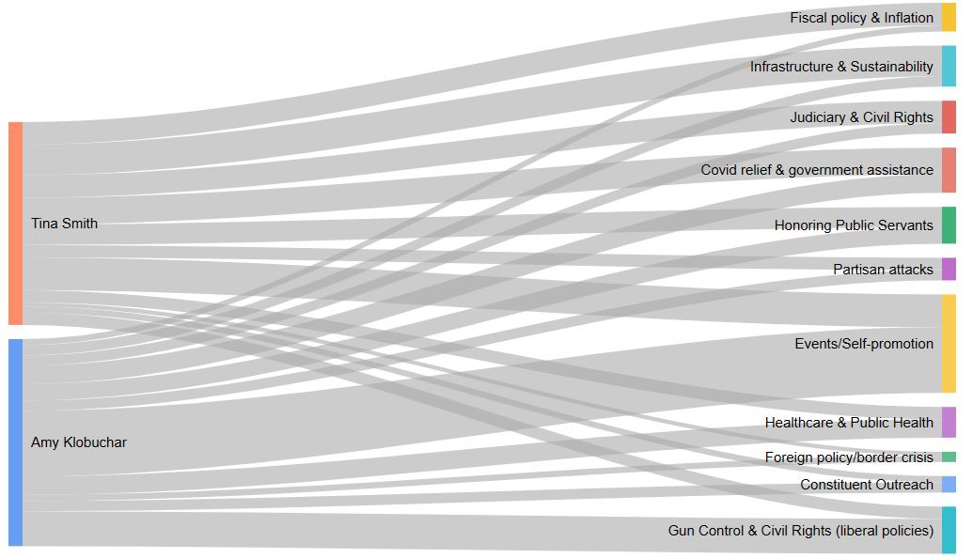
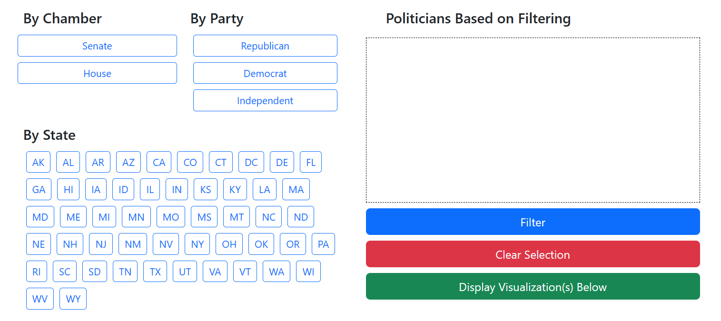
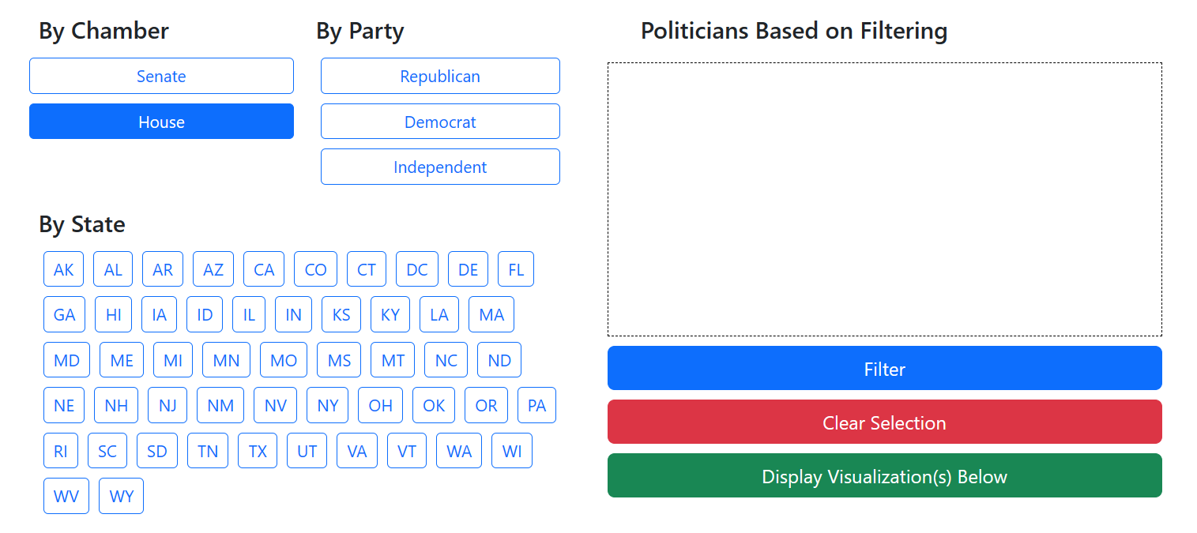
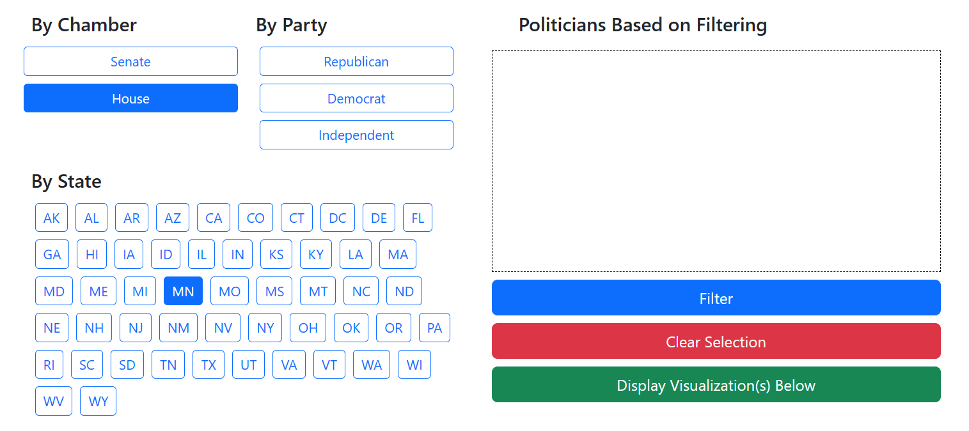
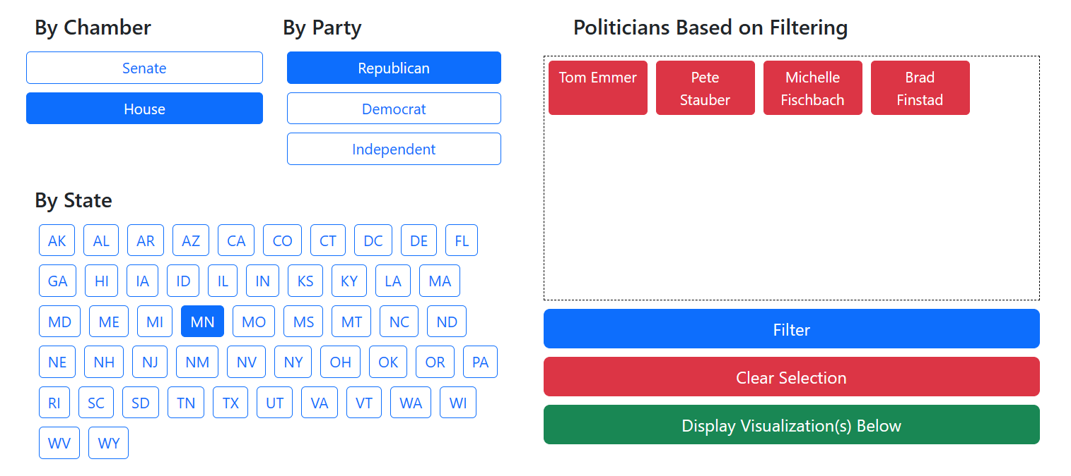
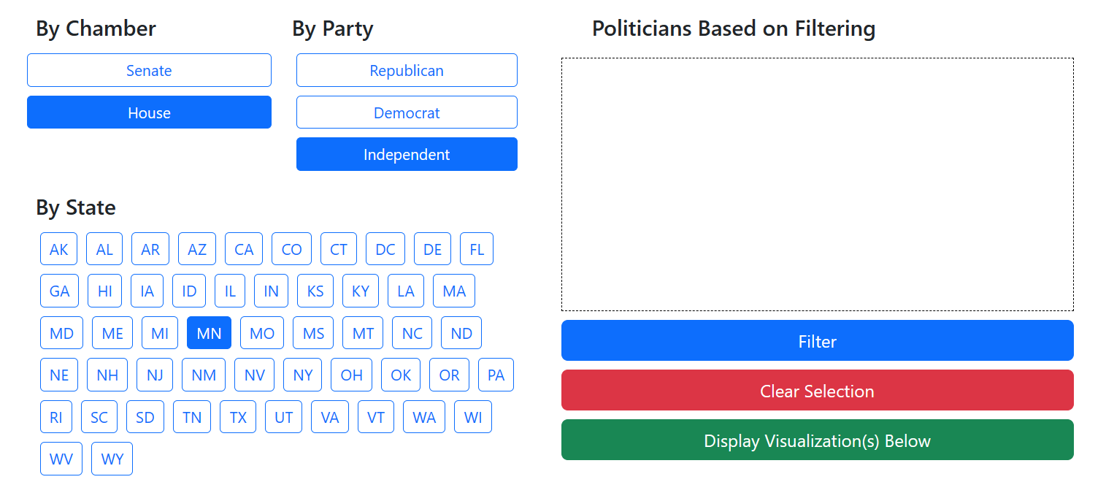
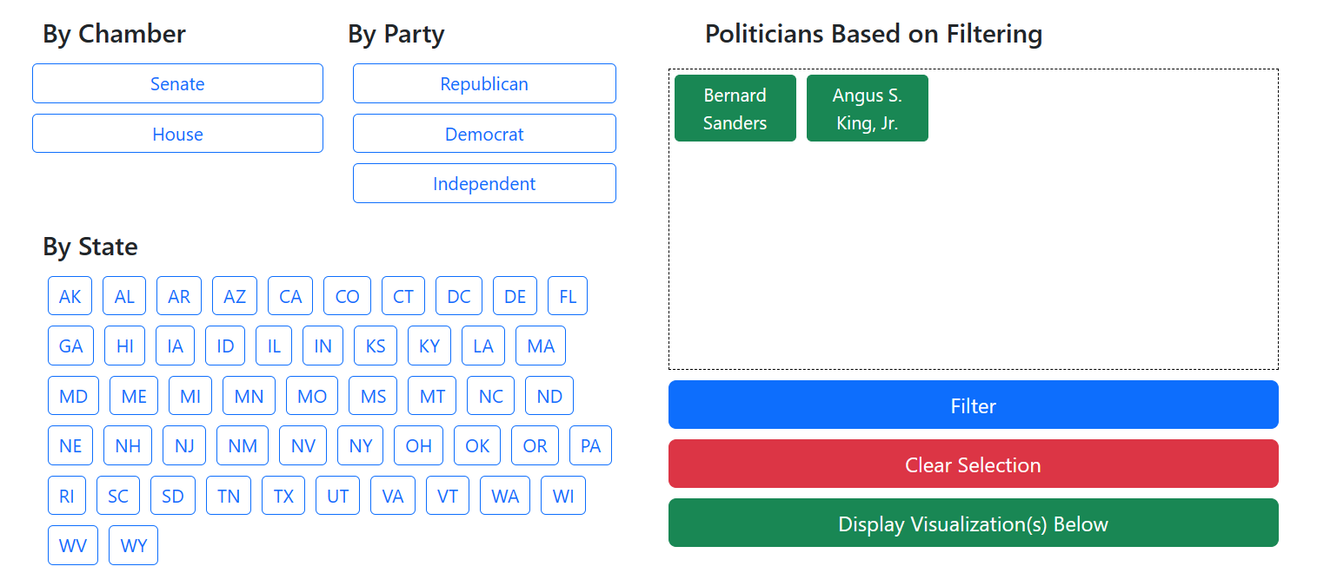
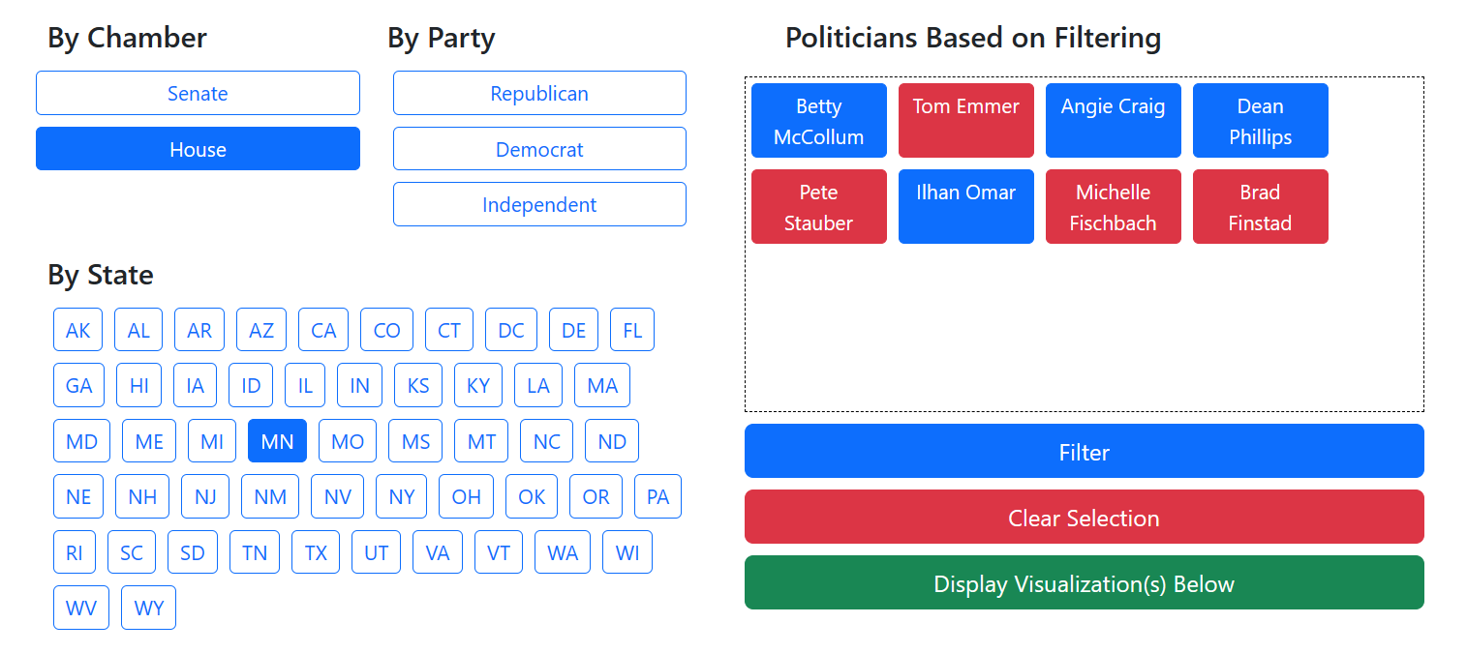
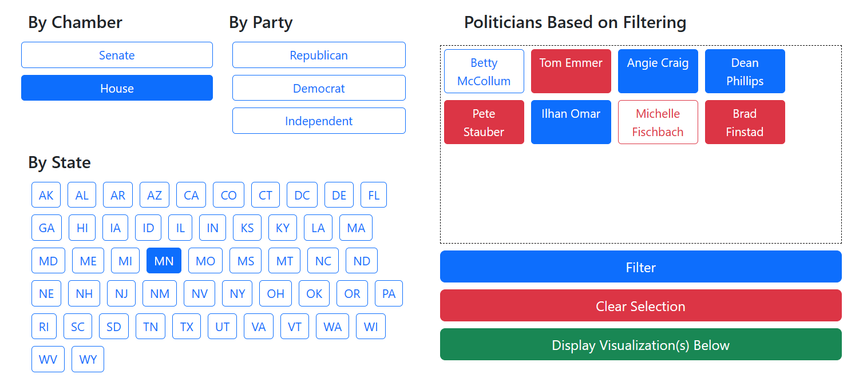
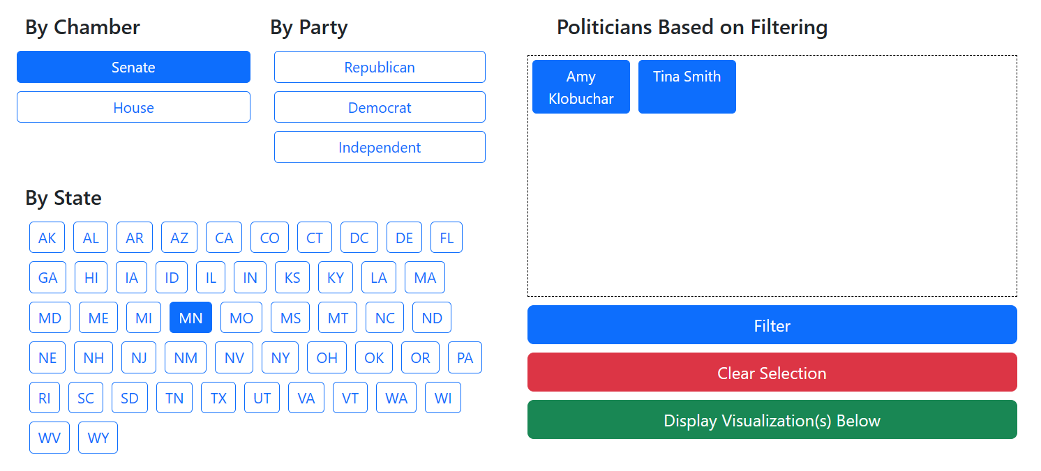
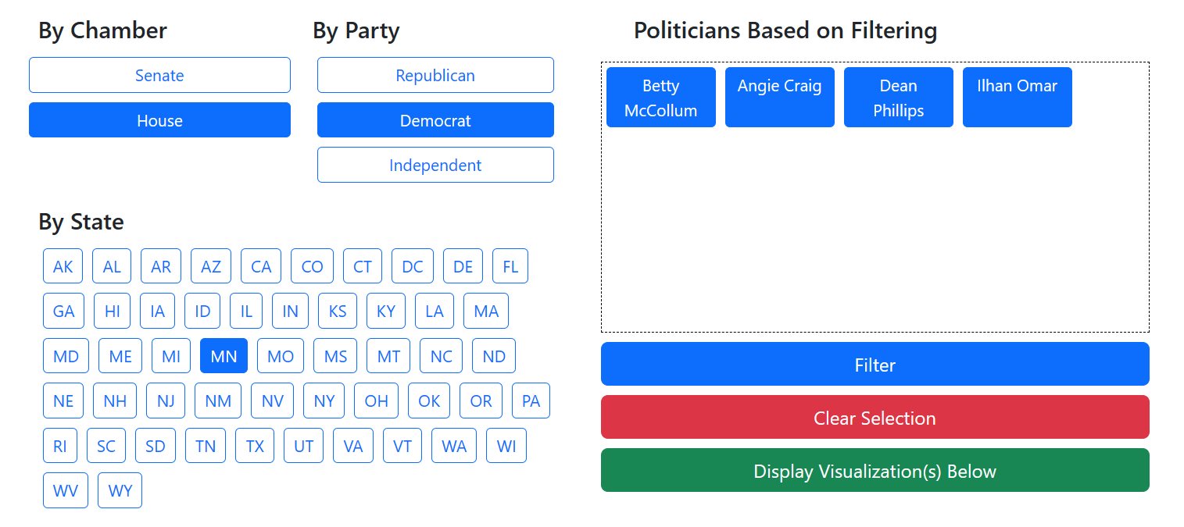
Front End: Interactivity
Notes:
CHISOM
Anna has talked about representing the data. What I focused on the most was figuring out how the user was going to interact with said data. As you can see there, there are a bunch of buttons. Quite a lot of them (if you consider each state having its own individual button). As a user, you can filter the list of federal congresspeople chamber, party, or state (and any combination of those filters). I’m just going to quickly illustrate how you would interact with this filtering system.
Let’s say I want to see information about MN representatives. What if I filter by party? By clicking “filter” after making my selections, the congresspeople that meet that criteria are displayed in the box on the right. Here’s are the republican Minnesotan representatives. And finally those who identify themselves with the Independent party.
Because there aren’t any Minnesotan congresspeople who aren’t associated with the independent party, no one shows up (and in case you’re wondering, there are only two politicians associated with the independent party: Bernie Sanders from Vermont and Angus King Jr. from Maine).
But let’s go back to House representatives from Minnesota. Here they are on the right. Something to note: as you have probably noticed, the buttons with the politicians’ names (which I will call poliButtons) are “filled” in. In other words, they are already pre-selected. So, when the user clicks “Display visualization(s) below”, you will be presented with sankey diagrams that contain information about all of them.
Due to the complexity of the data and the fact that congresspeople can be write tweets about various topics, receive funding from different industries, and talk about a variety of topics, we recommend having up to 10 congresspeople selected before displaying the sankey diagrams because there’s only so much that can be seen without it being overwhelming.
If you want to refine who’s data you see, you can also deselect them and then display their information
Just to give you an example of the data that you would see: if I wanted to know more information about the topics of tweets by the senators from Minnesota, ______ and _____, I would filter accordingly, then click “Display Visualization(s) Below”. This sankey would be one of the three displayed (the other two being industry funding and statement topics), and with it, I can see (include topics and stuff)

